Slide 1
Create a Report with Stored Procedure
Lecturer: Ngo Huy Bien
Software Engineering Department
Faculty of Information Technology
VNUHCM - University of Science
Ho Chi Minh City, Vietnam
nhbien@fit.hcmus.edu.vn

Slide 2

Objectives

Slide 3

Contents

Slide 4

References
Brian Larson (2017). Microsoft SQL Server 2016 Reporting Services. McGraw-Hill Education.

Slide 5
1. Open Report Data Pane
Turn on Caps Lock
CTRL + ALT + D

Slide 6
2. Add a Report Data Source (I)
This data source belongs to the report.

Slide 7
3. Add a Report Data Source (II)

Slide 8
4. Add the First Data Set (I)
This data set belongs to the report.

Slide 9
5. Add the First Data Set (II)

Slide 10
6. Add the Second Data Set (I)
This data set belongs to the report.

Slide 11
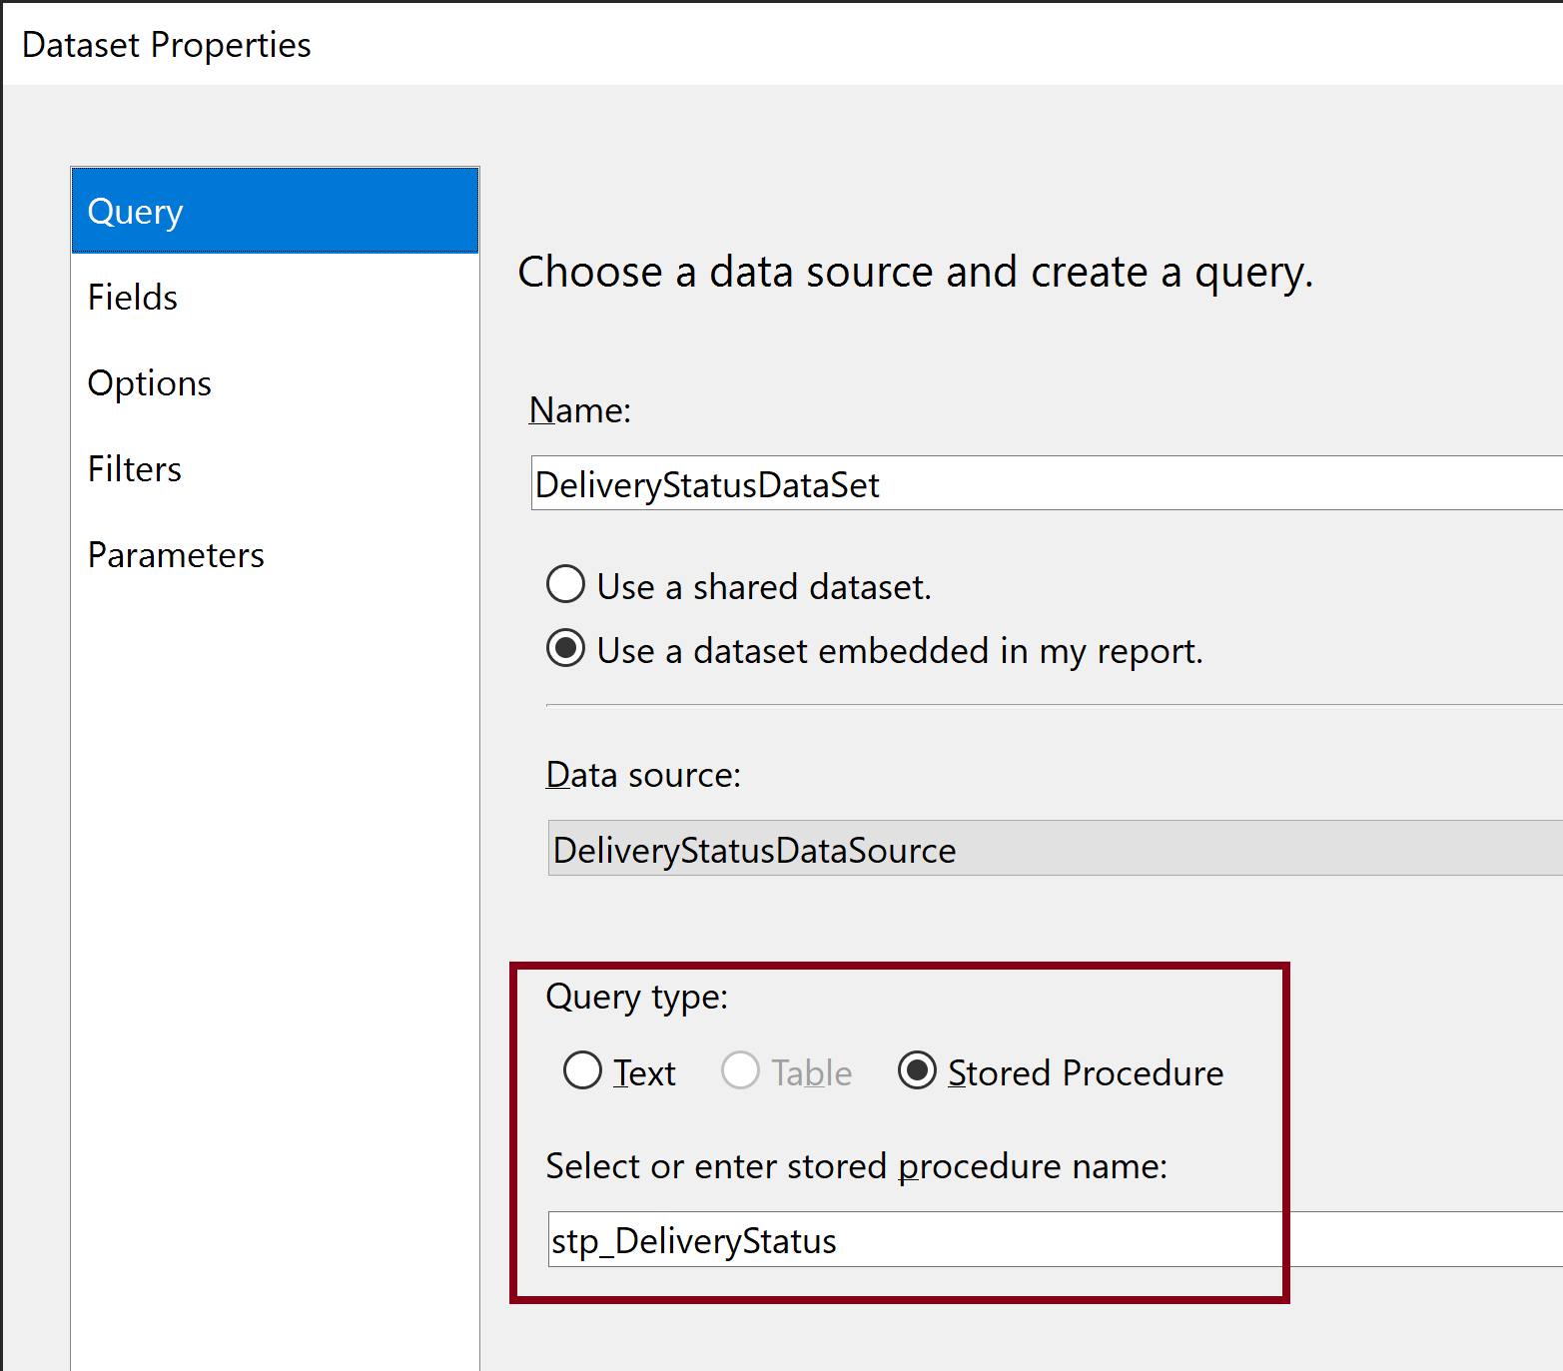
7. Add the Second Data Set (II)

Slide 12
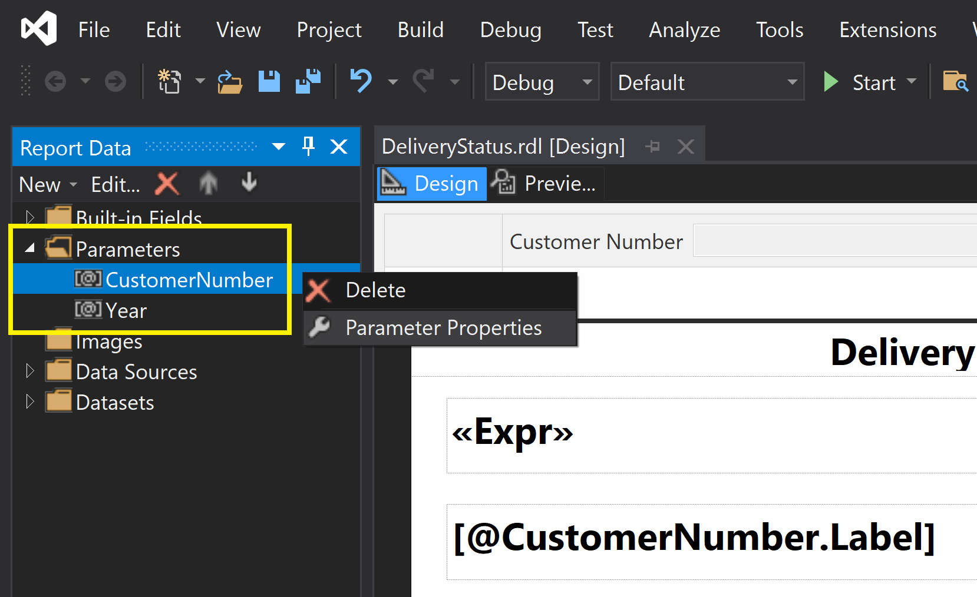
8. Configure Parameter Properties

Slide 13
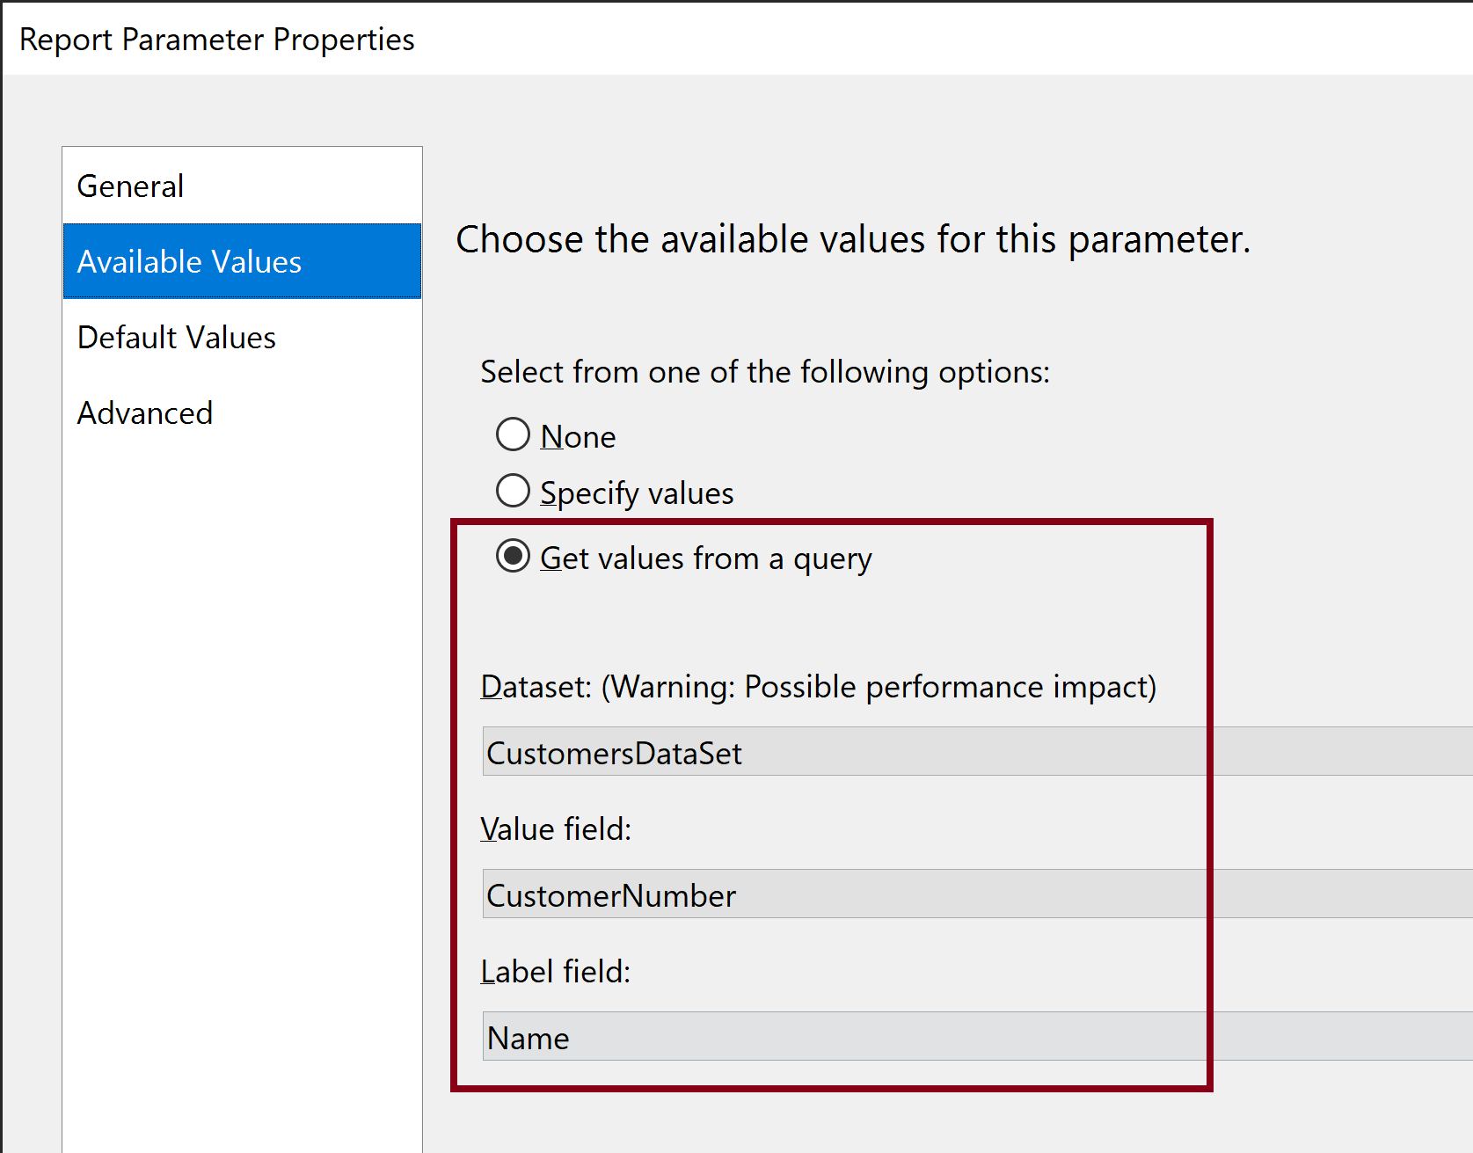
9. Set Available Values for Parameter

Slide 14
10. Open Toolbox

Slide 15
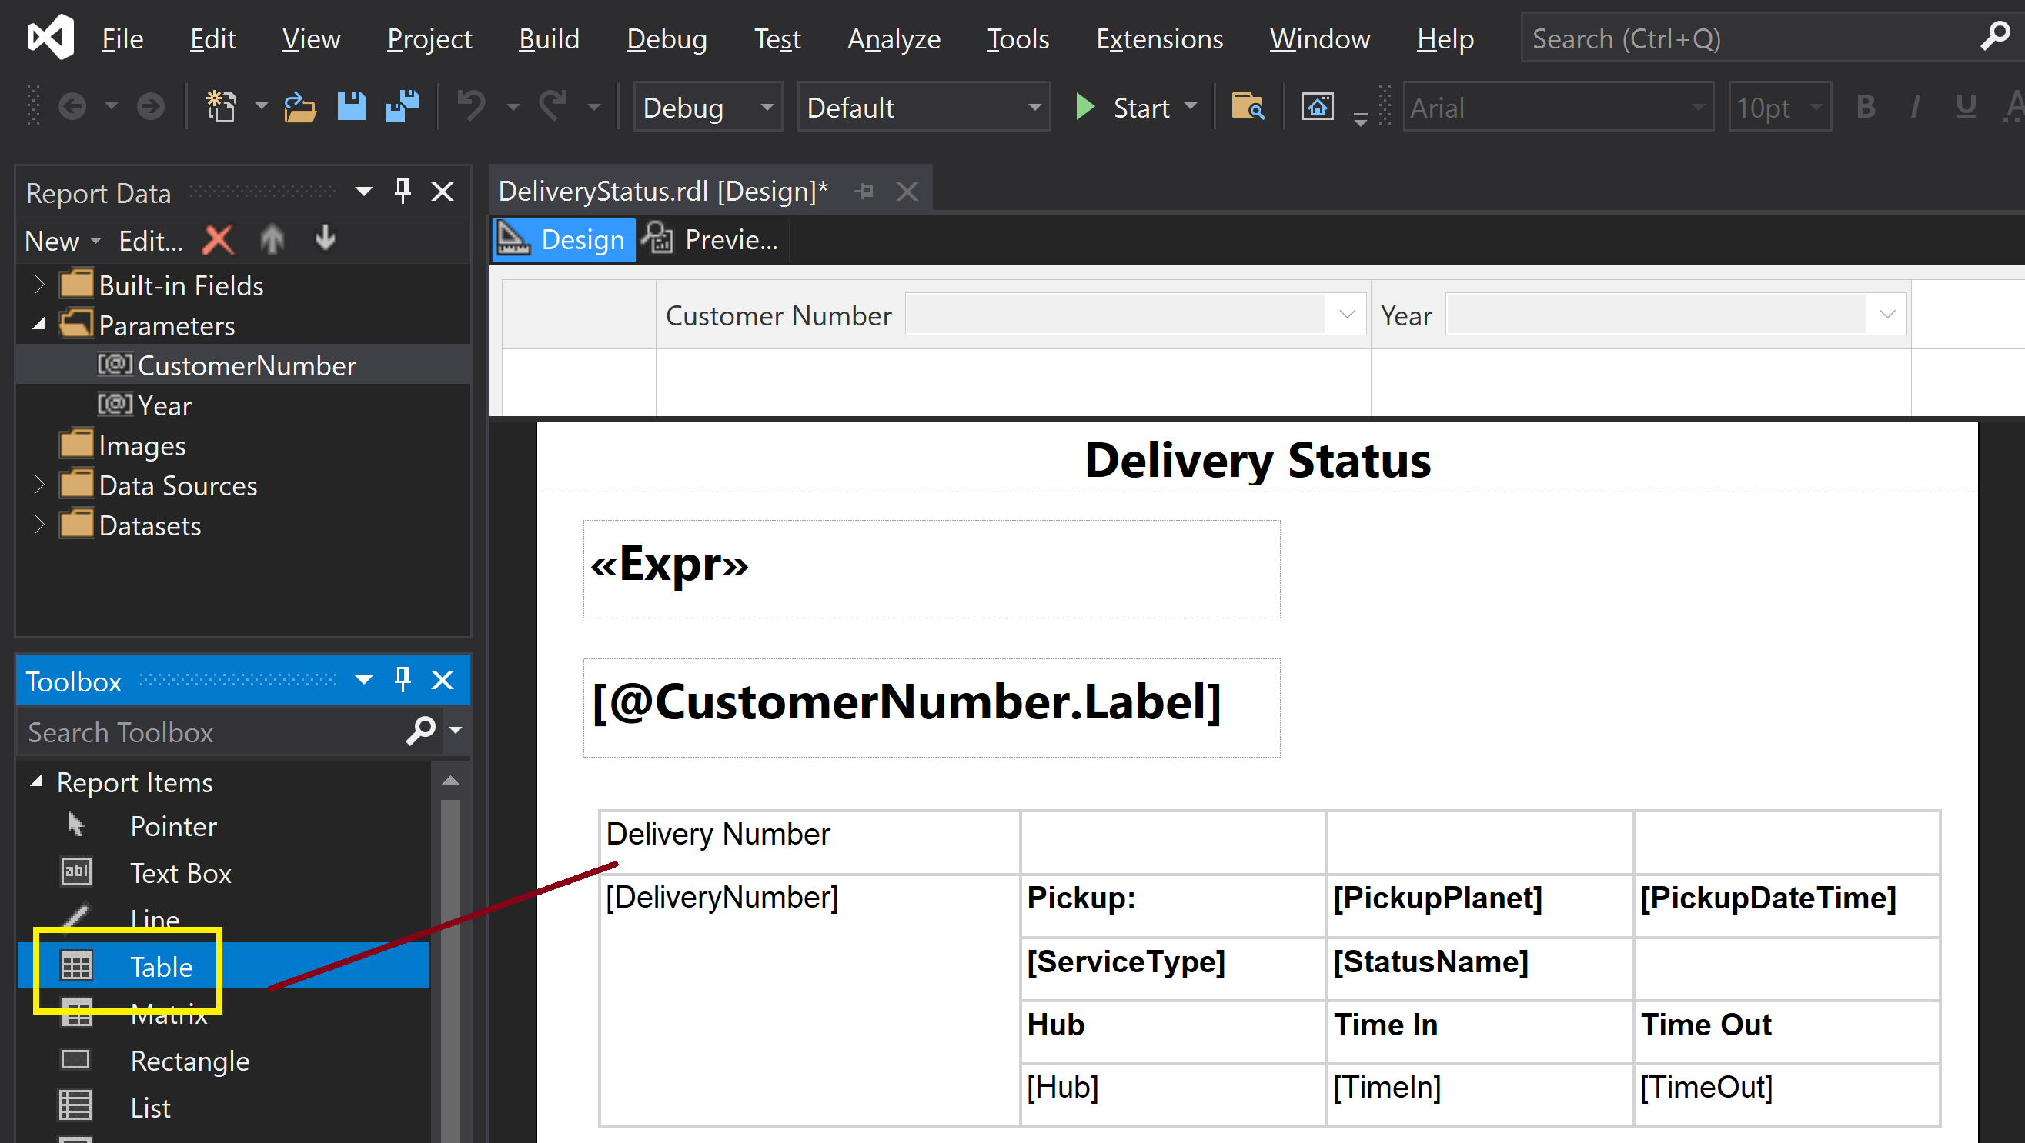
11. Add a Table to the Report

Slide 16
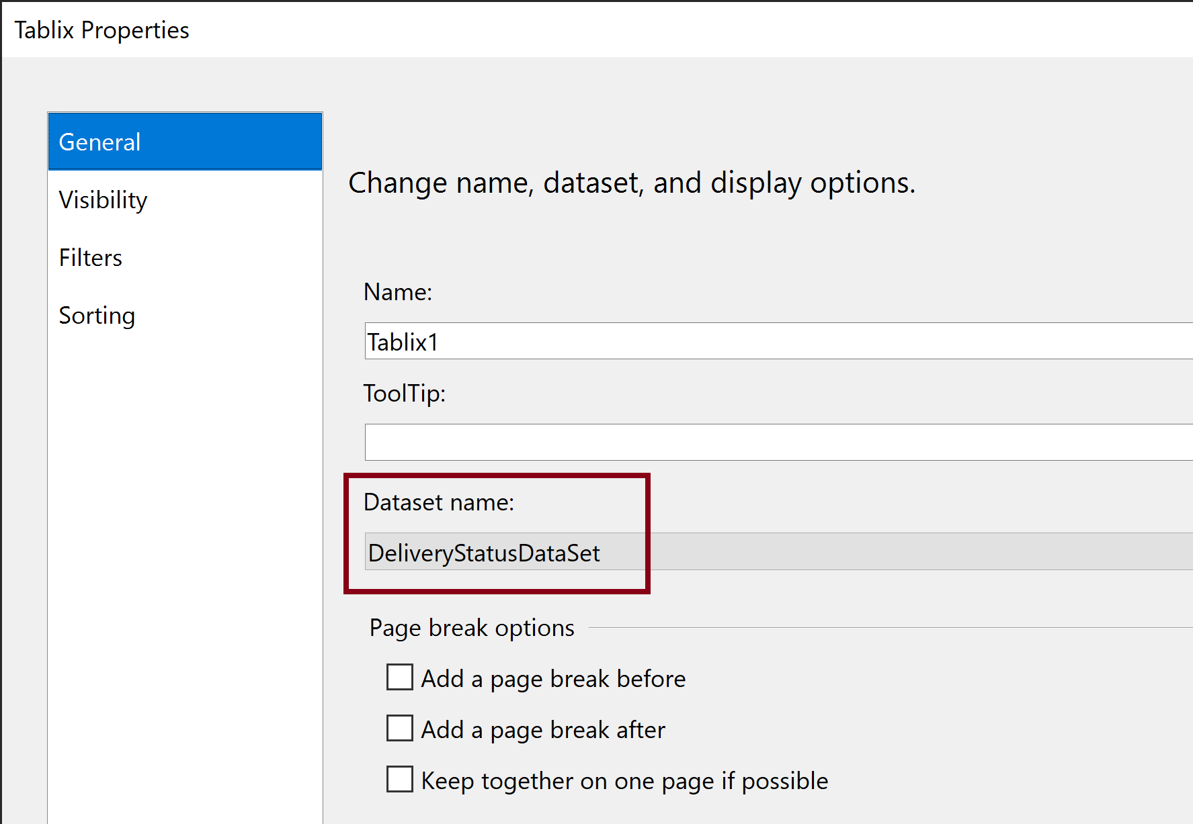
12. Set Data Source for the Table

Slide 17
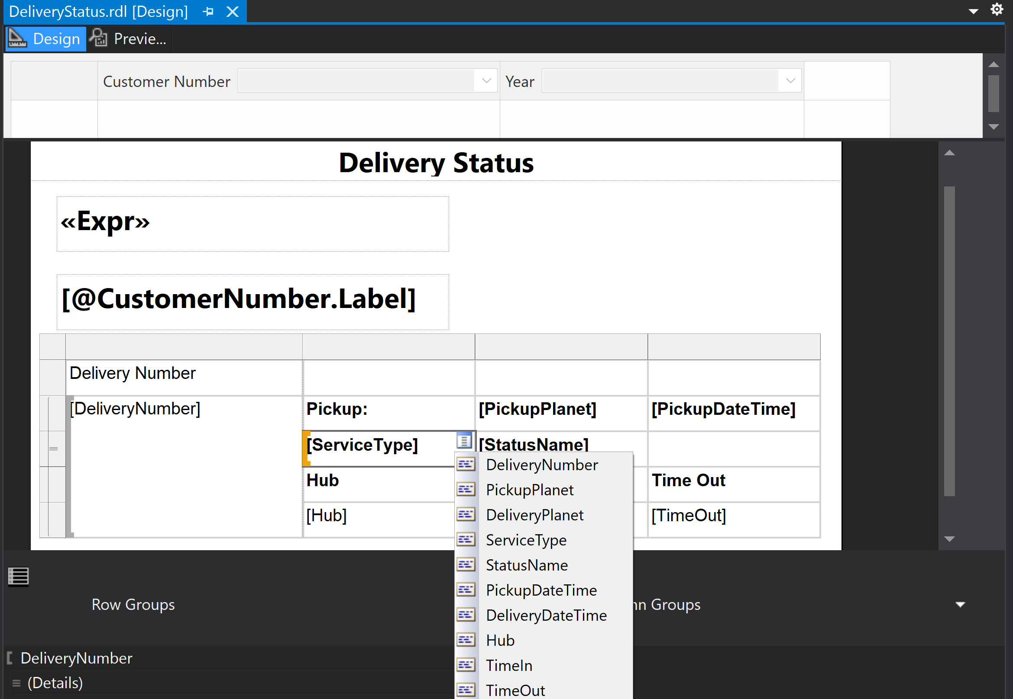
13. Set Table Cell Values

Slide 18
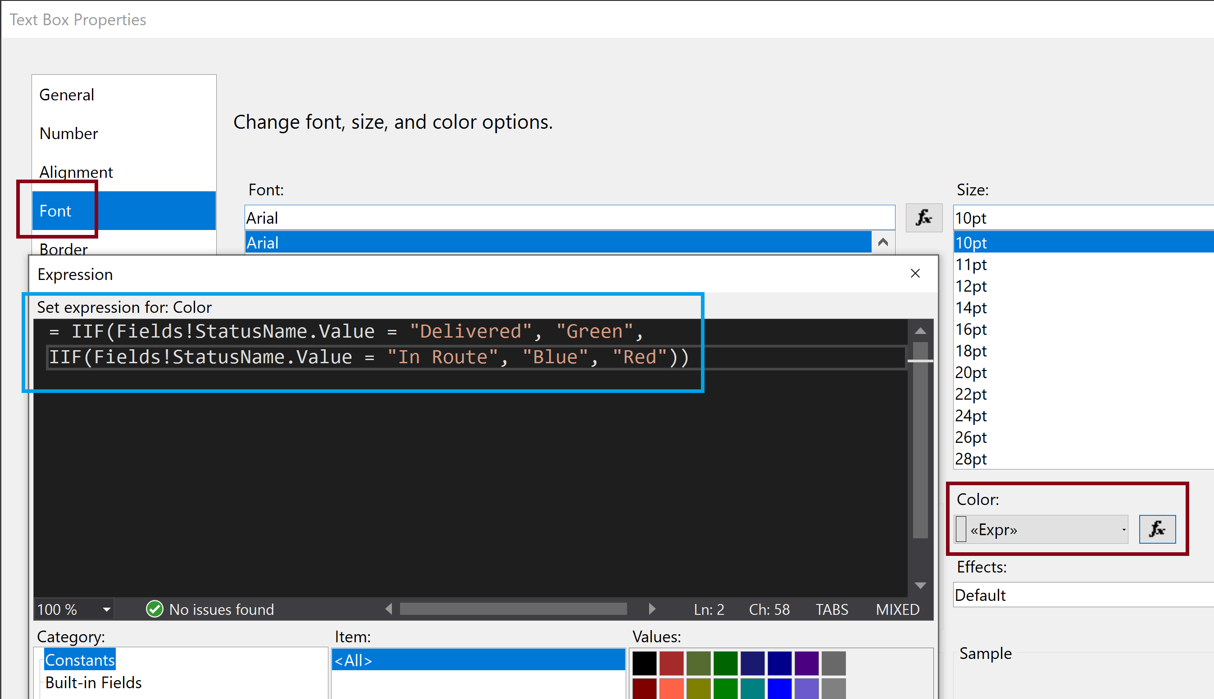
13. Create Dynamic Cell Color

Slide 19
14. Preview the Report

Slide 20
19. Test the Deployed Report

Slide 21

Thank You & See You Again

